Slide 1
Probing the neural mechanisms of adult-onset isolated focal dystonia
Presented by: Brendan Quinlivan
Supervisor: Prof. Richard Reilly

Slide 2
Dystonia Background
Dystonia is a neurological movement disorder
Recognised by sustained muscle contractions
Classified by genotype (where known), but more commonly, by phenotype
Highly debilitating disorder; poor public awareness
Treatment is most commonly botulinum toxin
Notes:
Dystonia is a common neurological movement disorder, recognised by sustained muscle contractions that cause twisting and repetitive movements or abnormal and sometimes painful postures.
Phenotype : Age of onset, affected body region and primary or secondary: Adult onset primary cervical dystonia is the most common in Ireland and is the focus of my doctoral research.
Classification : Cervical (most common), Cranial, Oromandibular or Limb
Poor public awareness leads to a feeling of isolation and results in a lack of diagnoses of the disorder.

Slide 3
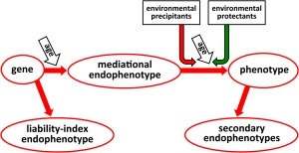
Dystonia Background
75% of cases appear to be sporadic, and in the familial cases, the penetrance is very low, making effective genotyping very challenging
A robust mediational endophenotype facilitate research in such disorders
Notes:
The sporadic nature of cervical dystonia makes genetic studies very difficult.
A mediational endophenotype is caused by the same genetic mutation as the phenotype, rather than a secondary endophenotype which is caused by the disorder and is not as useful for research purposes.

Slide 4
Mediational Endophenotypes
Mediational endophenotypes are subclinical quantitative markers of gene expression
The endophenotype must segregate with illness
The endophenotype must be present at a higher rate within affected families than in the population
Can elucidate the genetic basis and pathogenesis of disorders with low penetrance, such as dystonia or schizophrenia
Example : Reduced Prepulse Inhibition (PPI) has been observed in Schizophenia
Suggests an inability to filter out the unnecessary information
Caused by sensorimotor gating abnormalities, likely linked to dopaminergic abnormalities
Notes:
The sporadic nature of cervical dystonia makes genetic studies very difficult.
A mediational endophenotype is caused by the same genetic mutation as the phenotype, rather than a secondary endophenotype which is caused by the disorder and is not as useful for research purposes.

Slide 5
Temporal Discrimination
TDT is defined as the shortest detectable asynchrony between two stimuli
An abnormal temporal discrimination threshold (TDT) is a mediational endophenotype of cervical dystonia
Abnormal temporal discrimination is informative of disease pathogenies
The TDT allows us to look at large familial cases and draw comparisons between relatives with normal and abnormal TDT scores

Slide 6
Temporal Discrimination
Population distribution confirms that the TDT is a mediational and not a secondary endophenotype

Slide 7

Dystonia Background
Cervical dystonia is a disorder of the midbrain network for covert orientation of attention
This network is involved in the detection of, and response to, unexpected events
Figure from Thorn & Graybiel 2010
Notes:
This figure shows the subcortical basal ganglia circuit involved in the detection of, and response to, unexpected environmental events.

Slide 8
Research Question
The aim of my research is to test the hypothesis that abnormal TDTs and cervical dystonia are caused by a GABAergic deficit in the superior colliculus

Slide 9
Hypothesis
Cervical dystonia: Disinhibition of motor neurons in the intermediate and deep layers of the superior colliculus cause the abnormal movements characteristic of cervical dystonia
Abnormal TDT: Result from prolonged duration firing of visual sensory neurons in the superficial layers of the superior colliculus

Slide 10
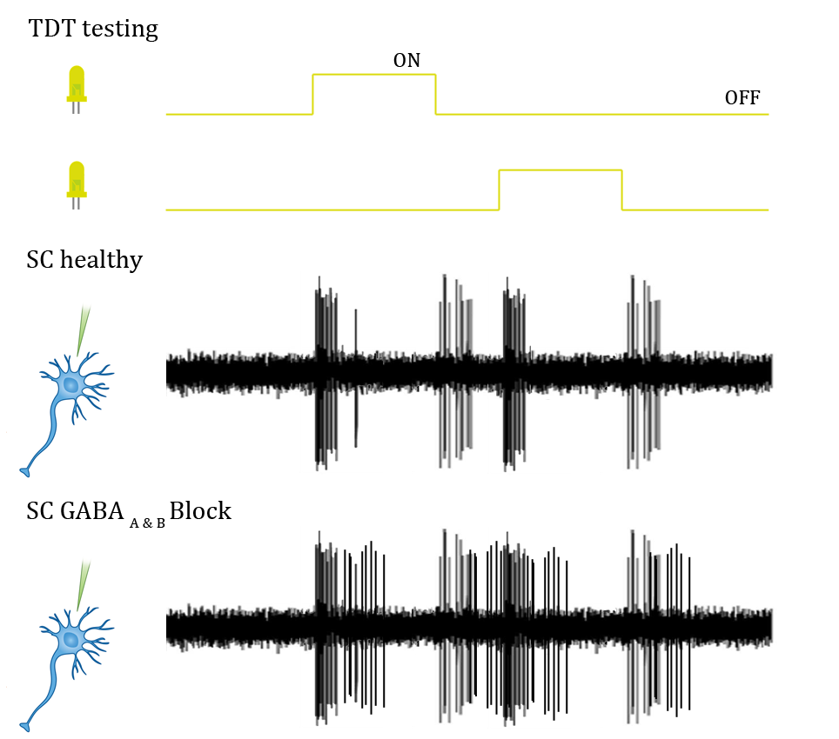
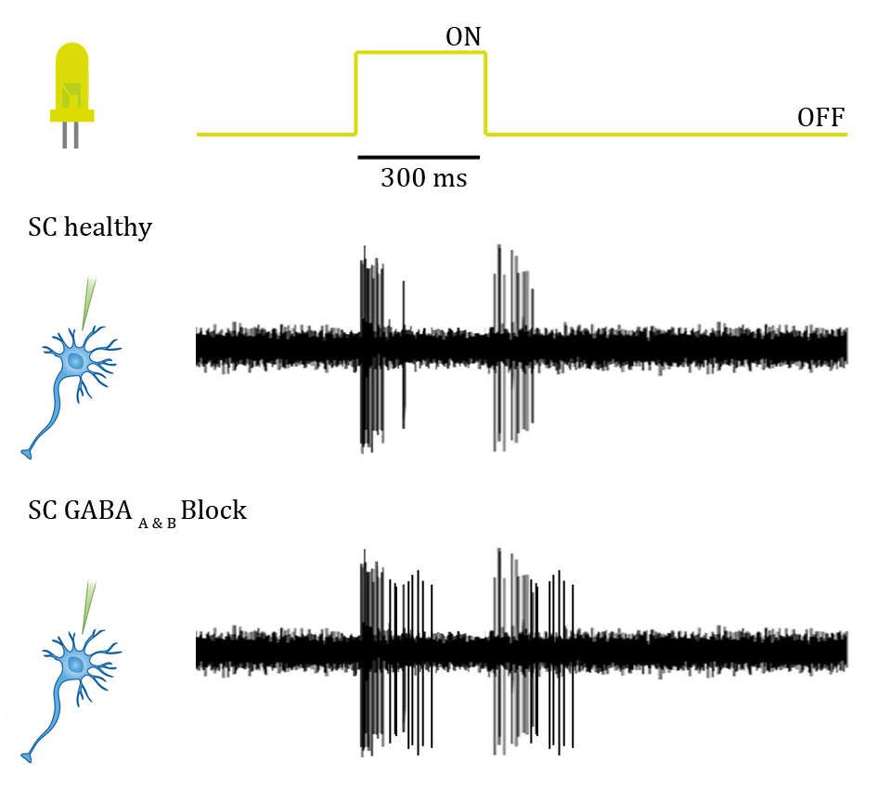
Explaining our hypothesis

Slide 11
Hypothesis
Cervical dystonia: Disinhibition of motor neurons in the intermediate and deep layers of the superior colliculus cause the abnormal movements characteristic of cervical dystonia
Abnormal TDT: Result from prolonged duration firing of visual sensory neurons in the superficial layers of the superior colliculus

Slide 12
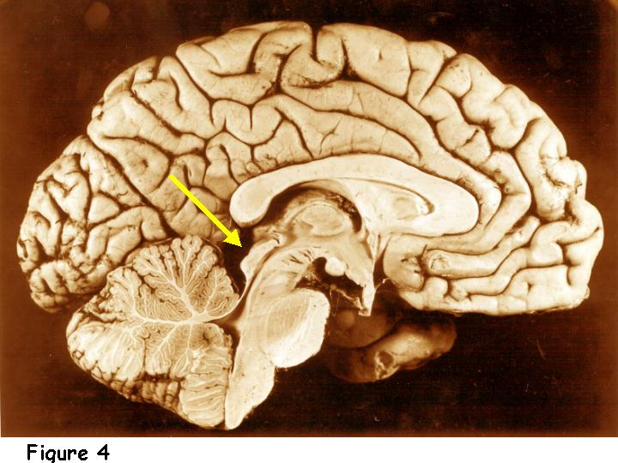
Studies
Looming responses in the SC: DCM analysis of fMRI during looming stimuli
Head kinematics, eye movement and orientation of attention
Visuospatial learning and electrophysiological correlates

Slide 13
Studies
Looming responses in the SC: DCM analysis of fMRI during looming stimuli
Head kinematics, eye movement and orientation of attention
Visuospatial learning and electrophysiological correlates

Slide 14
Motivations
Head movement
The deep and intermediate lamina of the SC generate saccadic head and eye movements
Under the current hypothesis, saccadic head movement should be abnormal in cervical dystonia
Covert orientation of attention:
The Posner task is commonly employed to measure the effects of covert orientation of attention.
SC is a key input to the network for covert orientation of attention and so we also expect to observe abnormalities in the manifestation of the Posner effect in patients

Slide 15
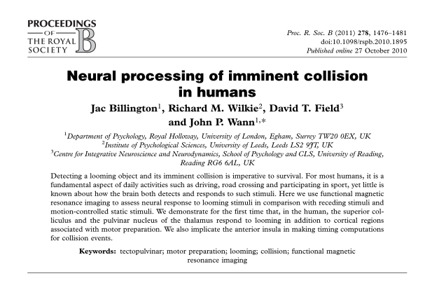
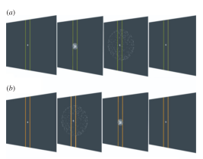
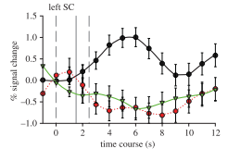
1. Looming responses in the SC
Paradigm based on that of Jac Billington et al. 2011
Successful in showing SC activity

Slide 16
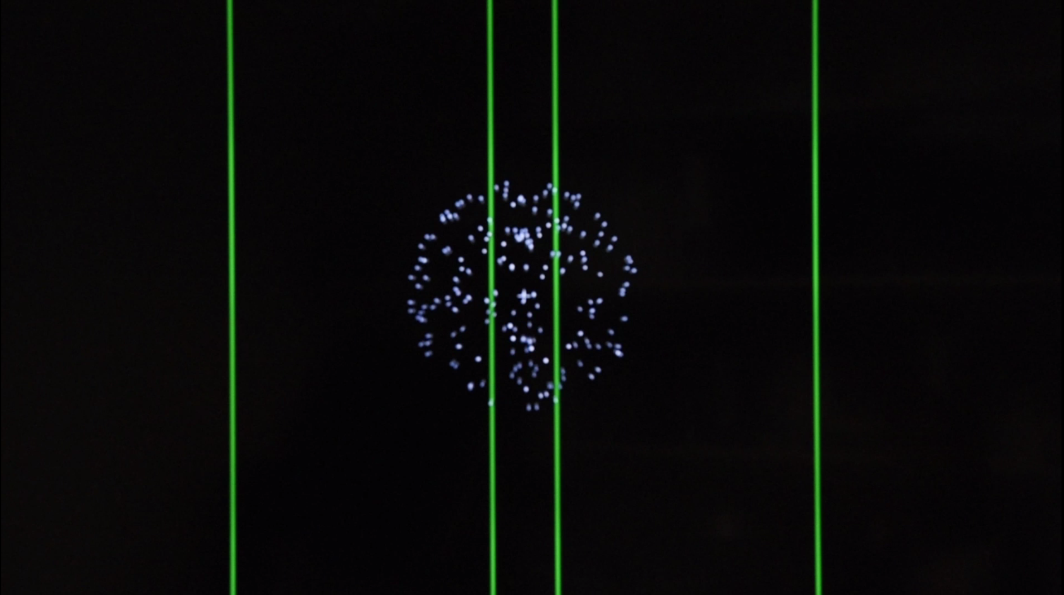

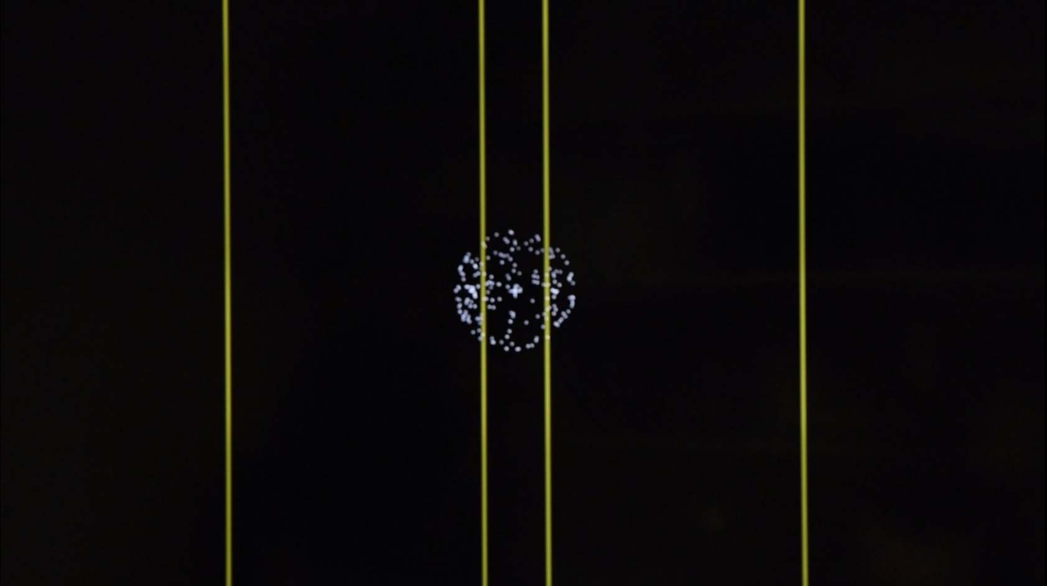
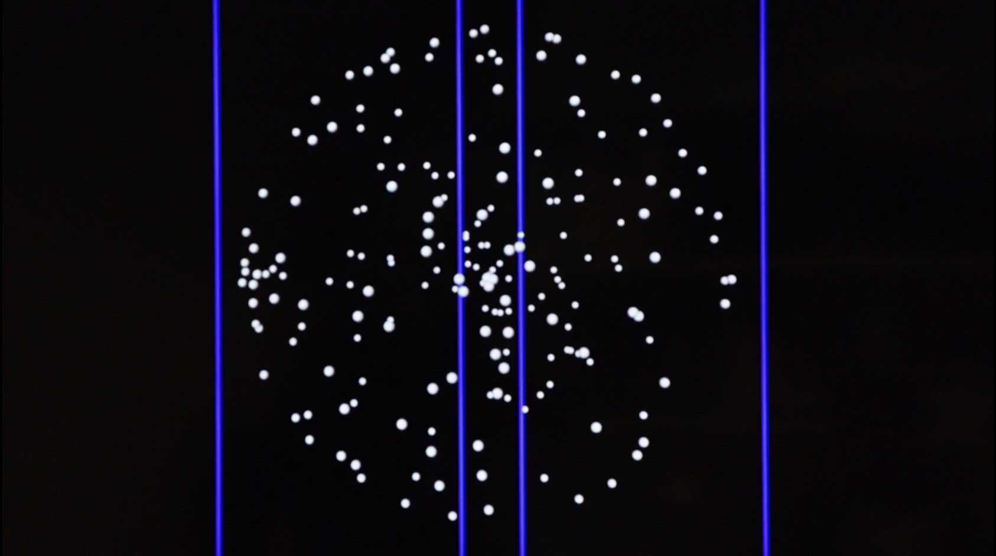
The Paradigm
Loom
Effect of interest
Recede
Control for structured movement
Random
Low level visual control

Slide 17
Participants
Normal Relatives
n = 18, 9 female, age = 51.7 ± 7.1
Abnormal Relatives
n = 18, 9 female, age = 54 ± 8.7
Subjects were asked to complete 4 blocks of 30 trials, presented in randomised order
Pre-processing
Realignment, co-registration, segmentation, normalization to mni space and smoothed with a 6mm kernel

Slide 18
Data Analysis
First Level GLM
Scans from 4 blocks were concatenated into single GLM
Onset times for Loom, Recede and Random motion were included
6 movement parameters included as nuisance regressors
Contrasts
1 sample: loom, recede, random
2 sample: loom vs. recede, loom vs. random, recede vs. random
Second Level GLM
Assess group level responses in the SC
Determine if paradigm is producing the expected results at the group level
Dynamic Causal Modelling (DCM)
More directly address the hypothesis of a GABAergic abnormality in cervical dystonia

Slide 19
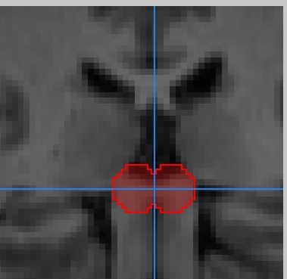
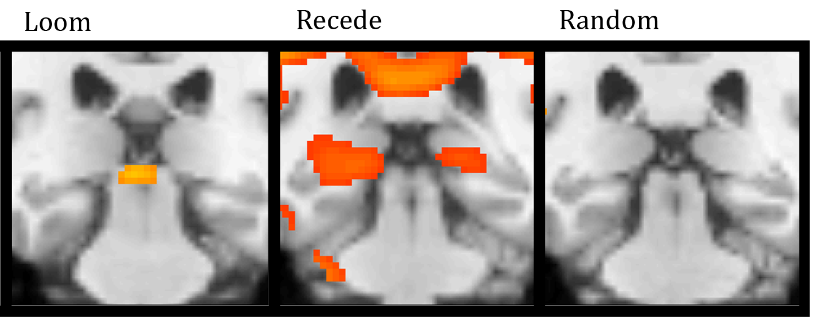
Second Level GLM results
Whole Group
1-sample contrast results
SC response to looming
No response for recede or random alone
Supports the findings of Billington et. al

Slide 20
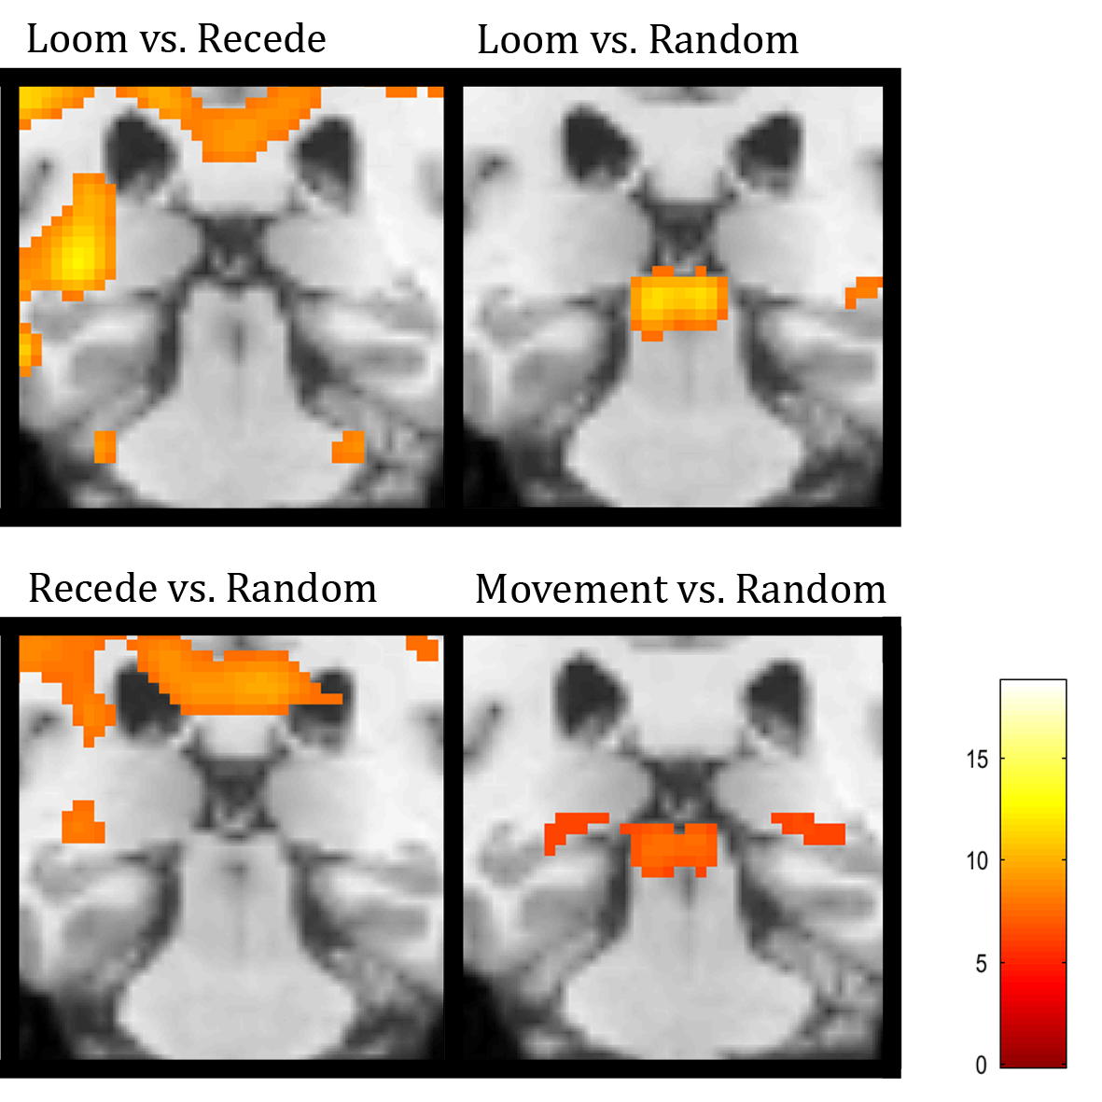
Second Level GLM results
Whole Group
2-sample contrast results
Significant response for loom vs. random
No response for loom vs. recede or recede vs. random
Also supports previous research, Billington et. al

Slide 21
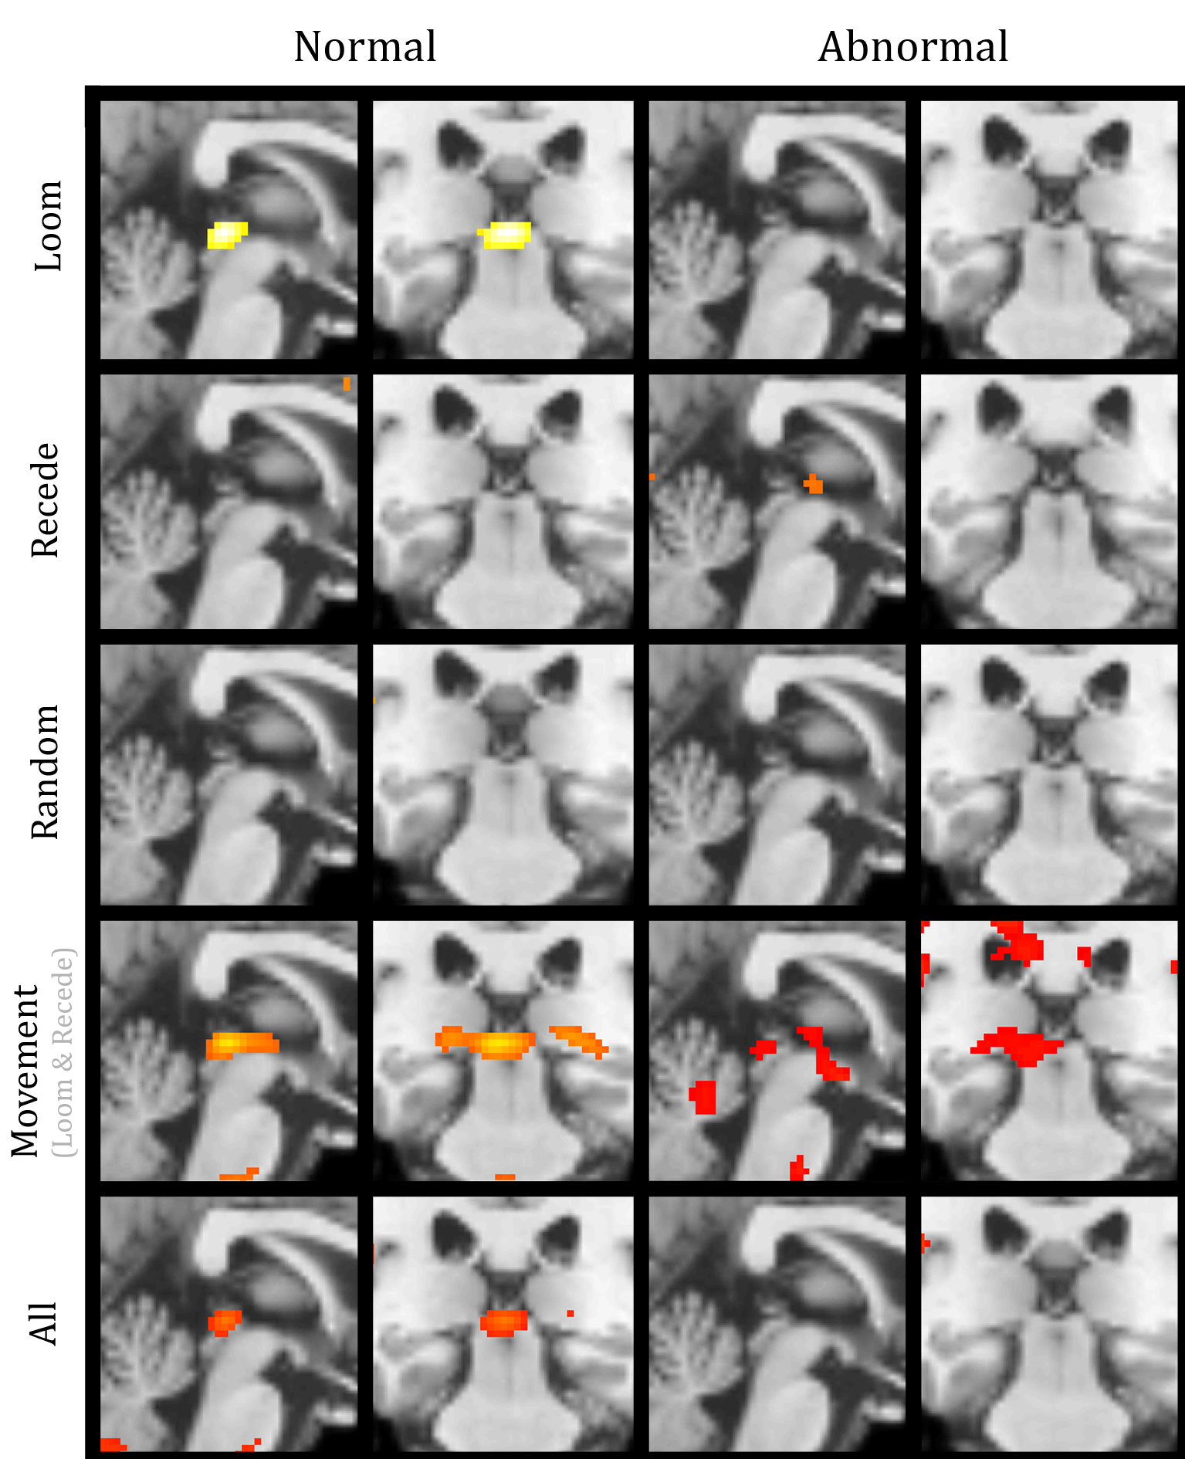
Second Level GLM results
Normal vs. abnormal relatives
1-sample contrast results
No response observed for recede or random in either group
Loom response observed in the normal group while no response was observed in the abnormal group
Supports the hypothesis that abnormal TDTs may be related to SC abnormalities

Slide 22
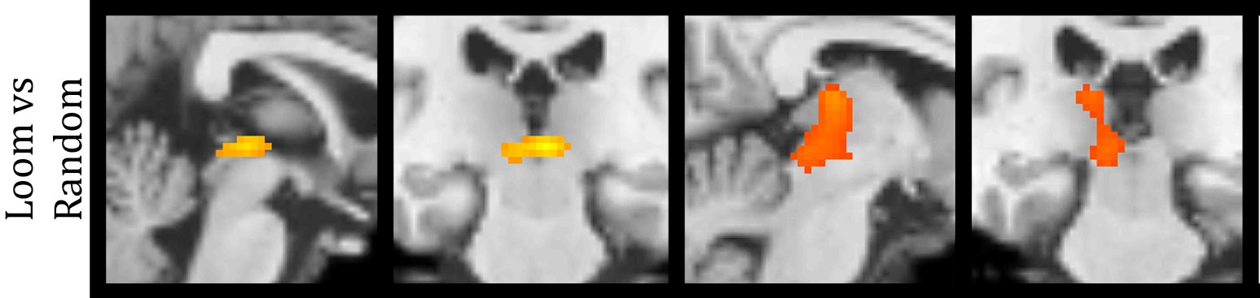
Second Level GLM results
Normal vs. abnormal relatives
2-sample contrast results
No response observed for loom vs. recede or recede vs. random
Significant difference for loom vs. random in both groups
Supports the hypothesis that abnormal TDTs may be related to SC abnormalities

Slide 23
Second Level GLM results: Summary
The results of the second level analysis show SC activation to looming stimulus and support the findings of Billington et. al
These results confirm the utility of this paradigm for the investigation of SC responses using fMRI
Normal/abnormal response differences to looming stimulus
Differences in activation between normal and abnormal relatives can be explored in greater detail using a DCM approach.

Slide 24
Data Analysis
First Level GLM
Scans from 4 blocks were concatenated into single GLM
Onset times for Loom, Recede and Random motion were included
6 movement parameters included as nuisance regressors
Contrasts
1 sample: loom, recede, random
2 sample: loom vs. recede, loom vs. random, recede vs. random
Second Level GLM
Assess group level responses in the SC
Determine if paradigm is producing the expected results at the group level
Dynamic Causal Modelling (DCM)
More directly address the hypothesis of a GABAergic abnormality in cervical dystonia

Slide 25
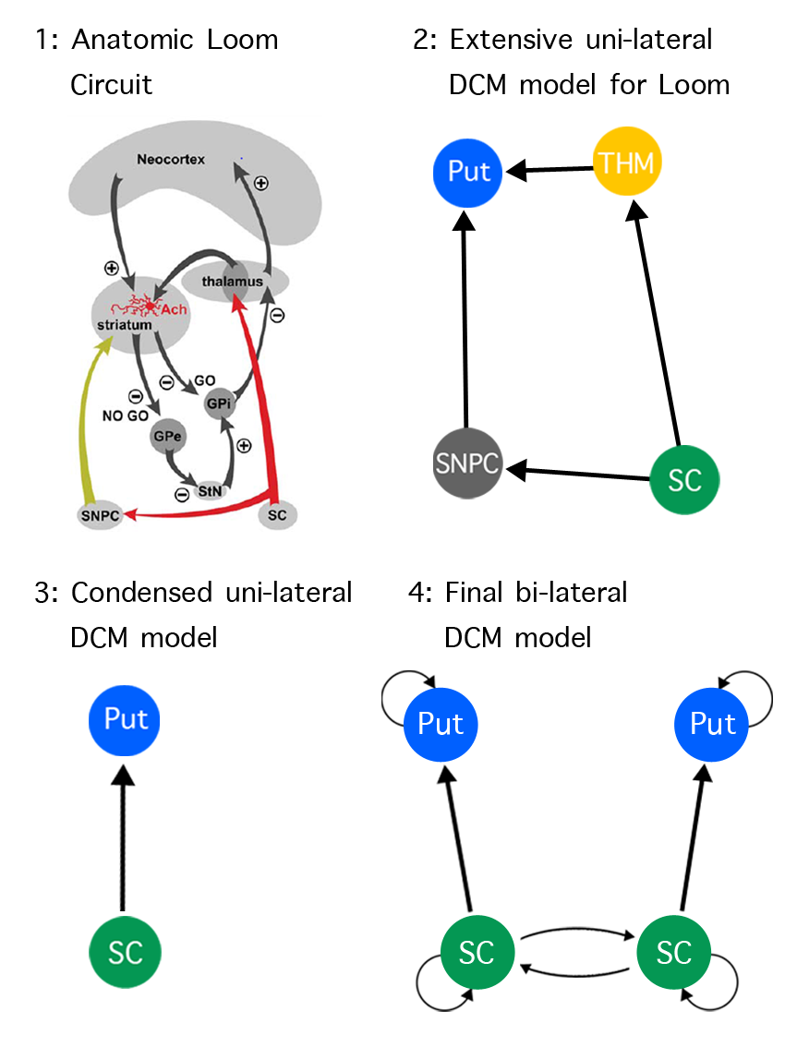
DCM results
A DCM approach may be able to shed more light on the group differences in looming responses

Slide 26
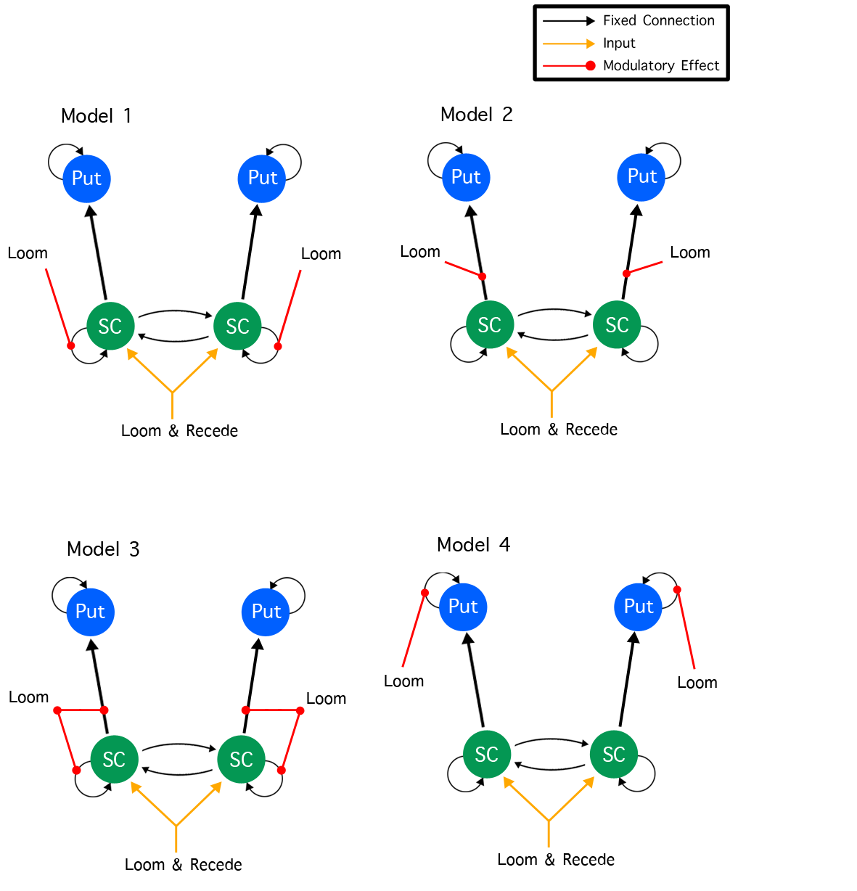
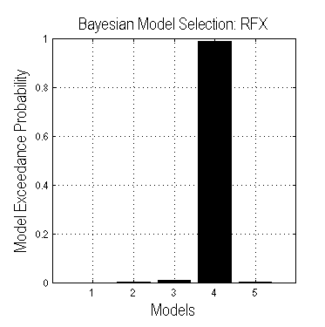
DCM results
Model 2
Model 3
Model 4
Model 5
Model 4, allowing modulation of SC inhibition and SC - putamen connections showed the best fit for the current data set
This model best represents the expected neural behavior as outlined in the literature

Slide 27
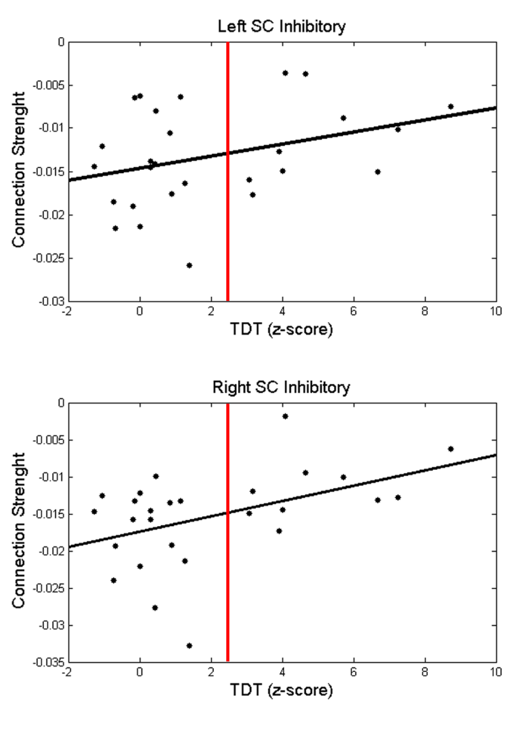
Superior Colliculus Inhibition
Parameters from the best model fit were extracted and a correlation analysis with TDT was carried out
Modelled SC inhibition was observed to reduced with increasing TDT scores
Supporting the hypotheses that reduced temporal discrimination is linked to abnormal GABAergic inhibition in the SC

Slide 28
Studies
Looming responses in the SC: DCM analysis of fMRI during looming stimuli
Head kinematics, eye movement and orientation of attention
Visuospatial learning and electrophysiological correlates

Slide 29
Motivations
Head movement
The deep and intermediate lamina of the SC generate saccadic head and eye movements
Under the current hypothesis, saccadic head movement should be abnormal in cervical dystonia
Covert orientation of attention:
The Posner task is commonly employed to measure the effects of covert orientation of attention.
SC is a key input to the network for covert orientation of attention and so we also expect to observe abnormalities in the manifestation of the Posner effect in patients

Slide 30
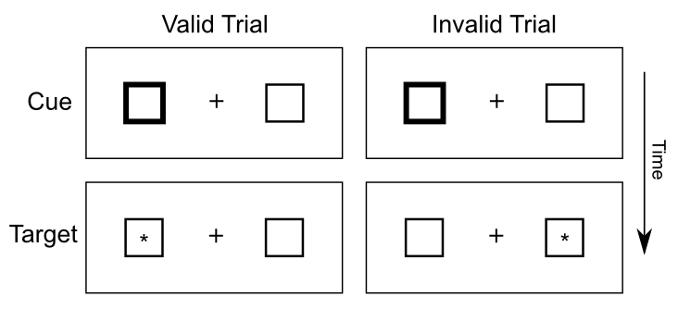
Posner Paradigm
The classic Posner task is a often employed to study covert orientation of attention
Cued reaction time task that typically employs button press or saccadic responses
Here we determine weather the Posner effect is present during onset of head movement

Slide 31
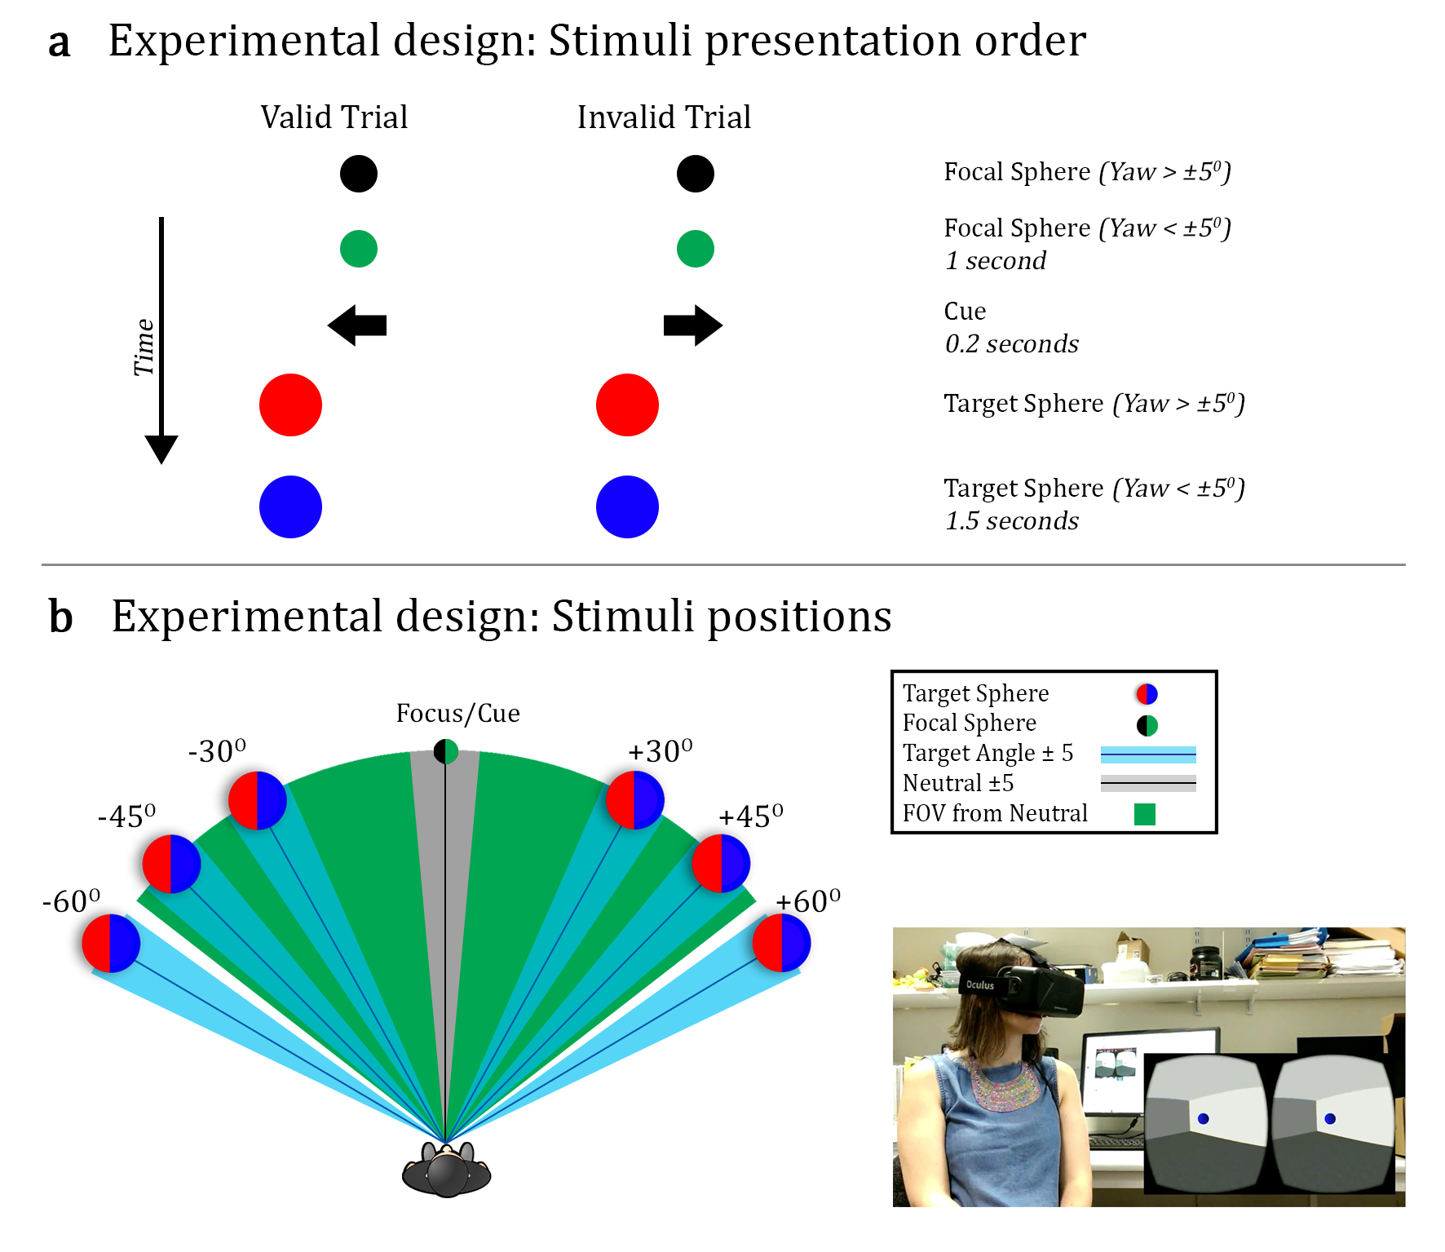
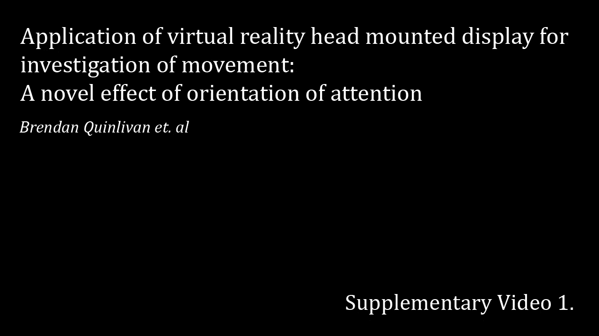
Modified Posner Paradigm

Slide 32

Studies
Validation study: Healthy control population
Designed to validate the proposed paradigm and ensure the presence of a Posner effect in onset of head movement
Clinical study: Compared Posner effect in healthy controls and cervical dystonia patients
The Posner effect is a self normalized and enables us to measure relative changes in orientation of attention

Slide 33
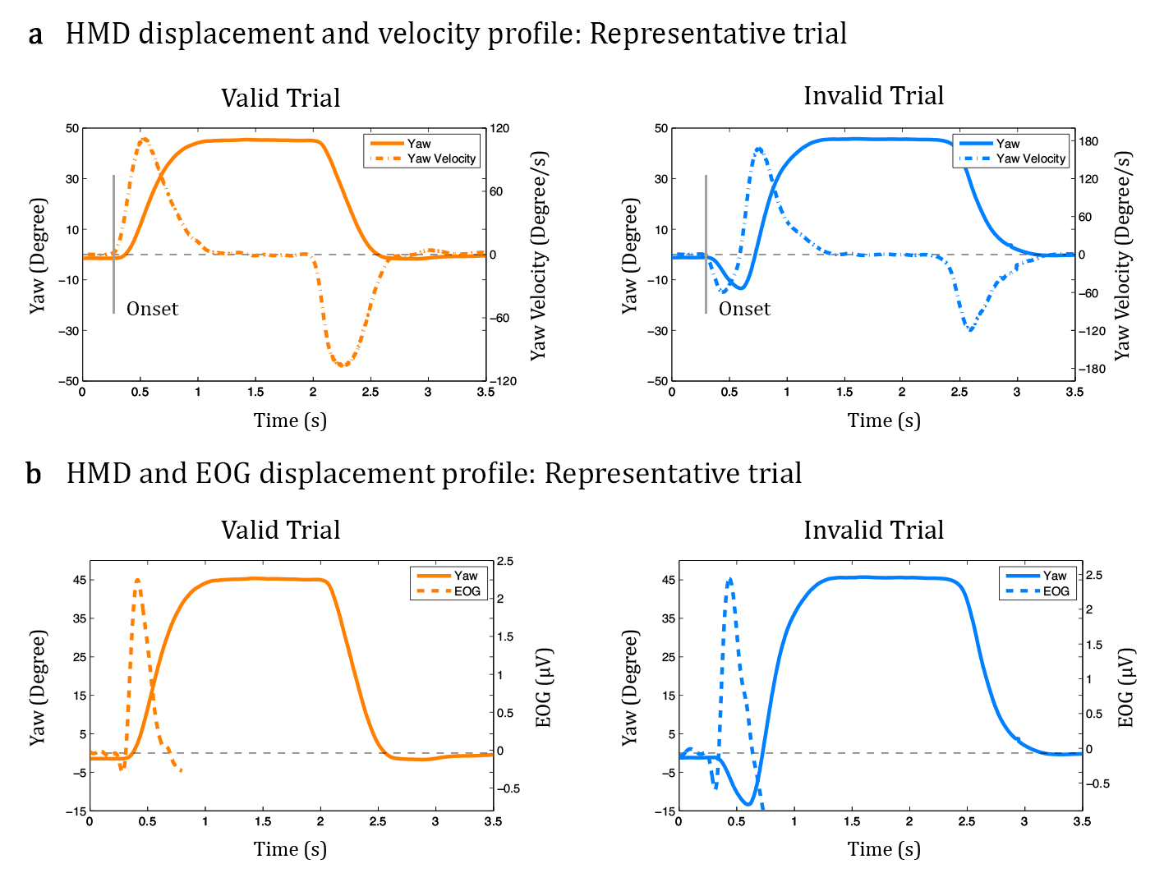
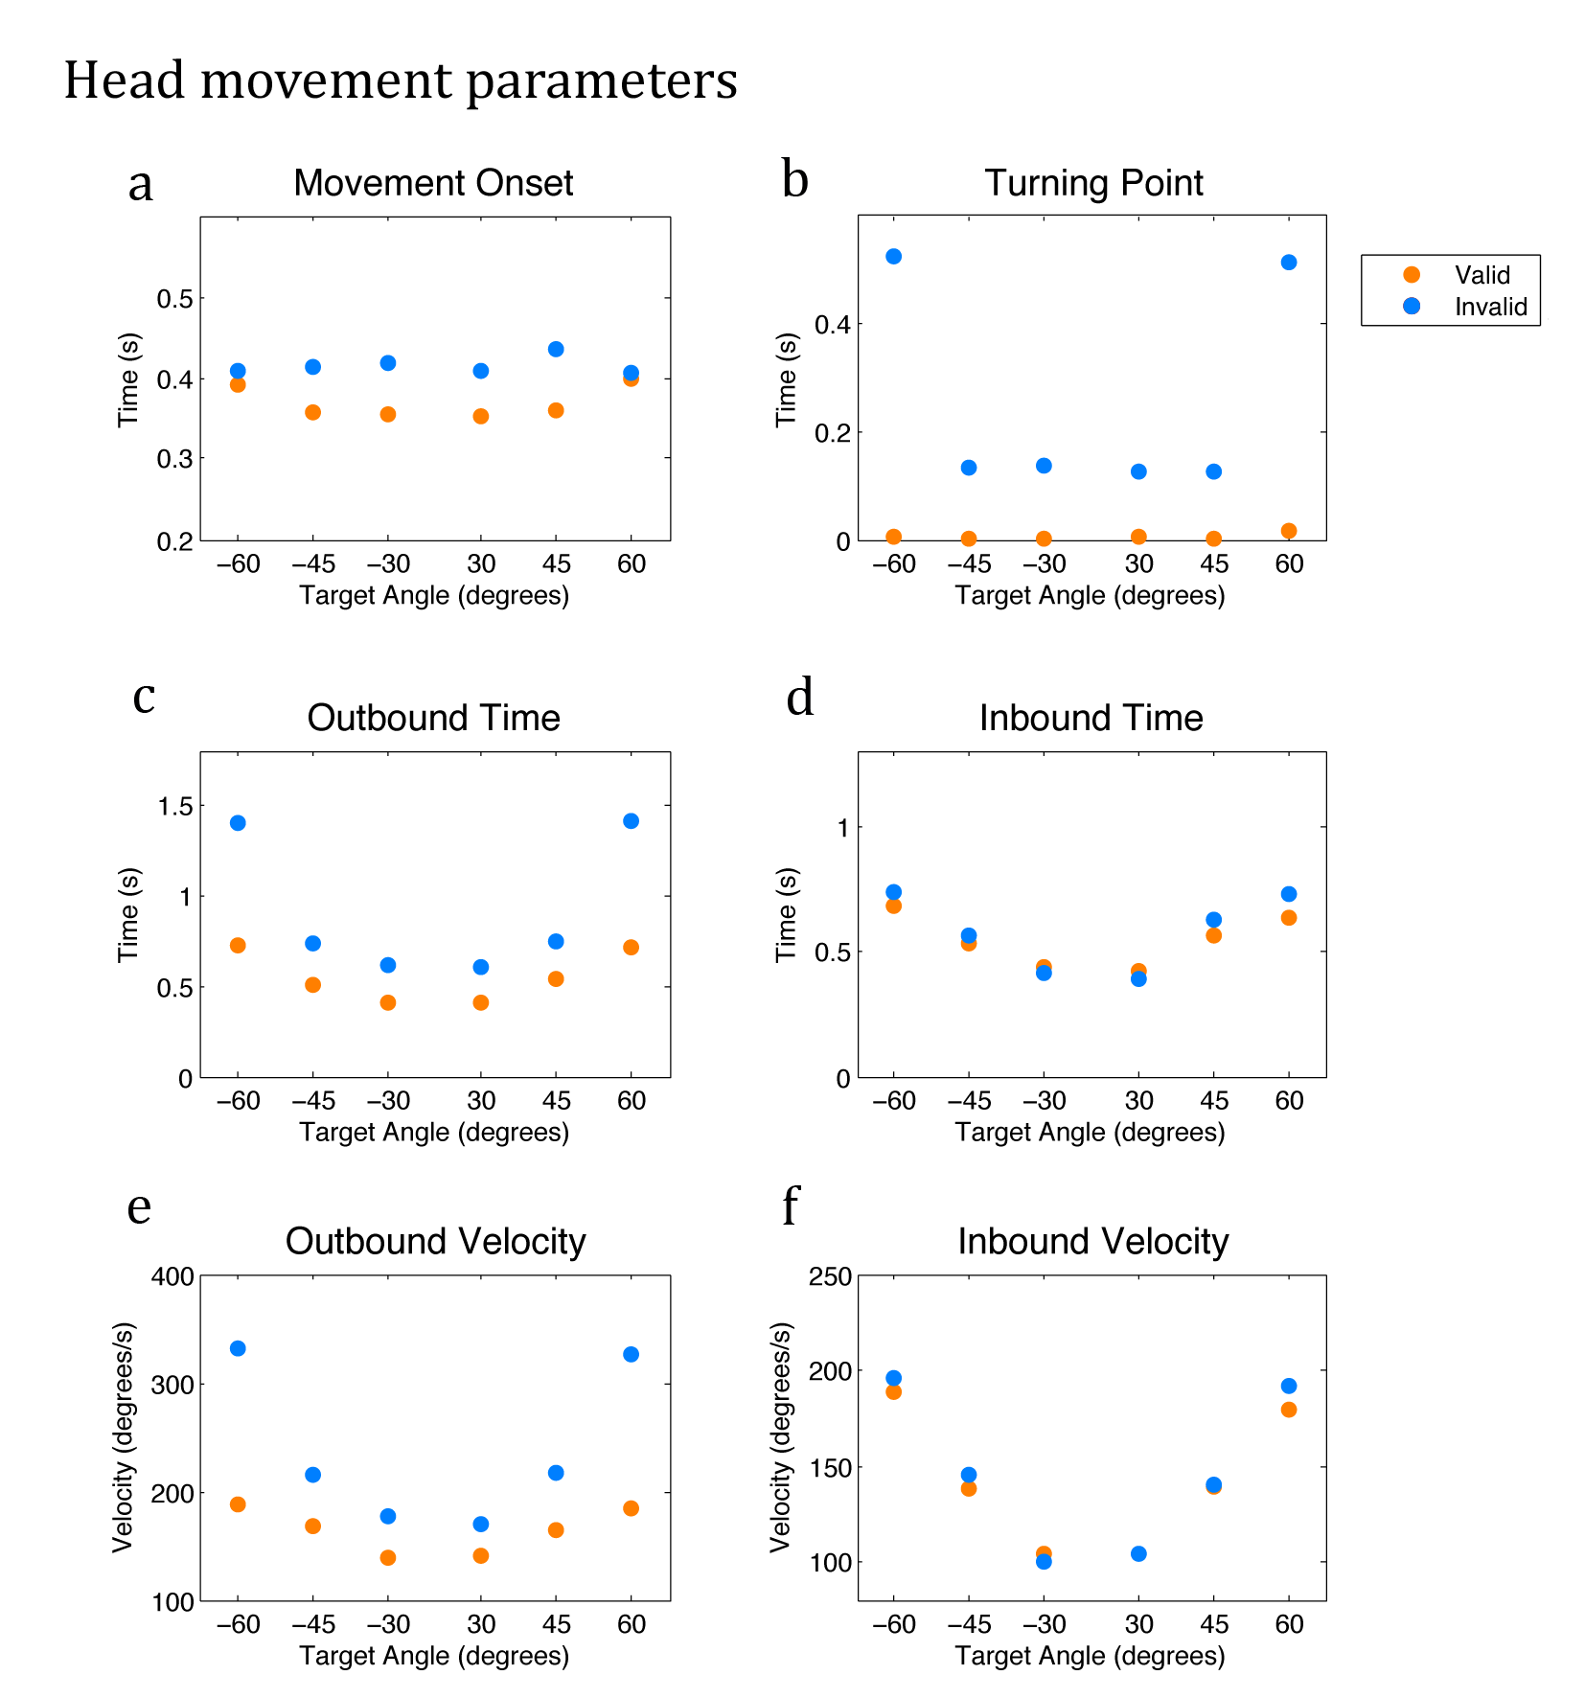
Validation Study

Slide 34
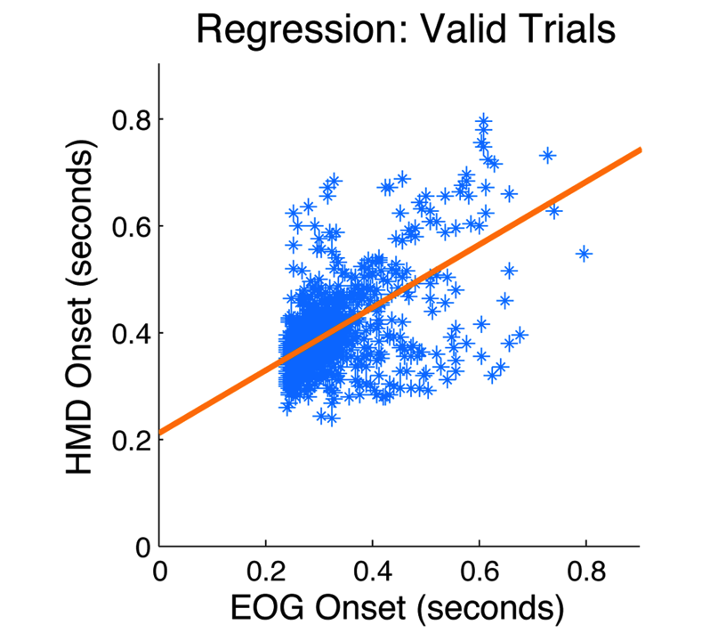
Validation Study
EOG onsets (gold standard) were highly related for those detected from HMD data (F(1, 1301) = 761.8, p < 0.001).

Slide 35
Clinical Study
The validated paradigm was then repeated for 28 cervical dystonia patients (53.8 ± 8.1) and for 38 (45.8 ± 9.5) age matched healthy control subjects
Analysis focused on onset of head movement and Posner effect as these metrics have the most relevance for the current hypothesis
Only angles that were observed to generate a Posner effect were included, trials at 60° were excluded

Slide 36
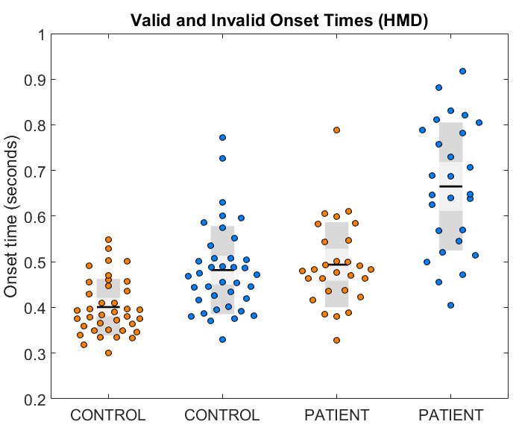
Results: Movement onset
Movement onset delayed for valid and invalid trials in the patient population
May reflect manifestation of disorder rather than SC abnormality

Slide 37
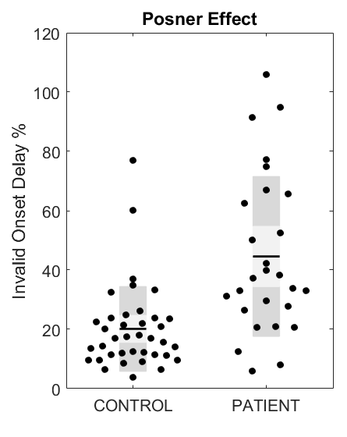
Results: Posner effect
The Posner effect is more than doubled in the patient population
Measured as a % change and so less sensitive to manifestation of disorder
Likely caused by a combination of SC abnormality and disordered movement
Future research should test if abnormal relatives also show an increased Posner effect

Slide 38
Studies
Looming responses in the SC: DCM analysis of fMRI during looming stimuli
Head kinematics, eye movement and orientation of attention
Visuospatial learning and electrophysiological correlates

Slide 39
Motivations
Visuospatial Learning
Visuospatial learning employs a number of key sub-cortical networks that may be affected in dystonia
Salient Cue
Studies have shown that visuospatial learning can be modulated by designing cues around known SC functionality REF
A salient cue was employed so task performance would be sensitive to SC abnormalities
Electroencephalogram (EEG)
Employing electrophysiological measurement provides the opportunity observe abnormalities that may not be visible in behavioral based responses

Slide 40
Methods
Participants were asked to complete two tasks while simultaneous EEG signals were recorded
Behavioural and electrophysiological parameters were then examined in relation to visuospatial learning
Behavioural: Movement durations were examined as a behavioural measure of visuospatial learning
EEG: Dynamic P3 responses and changes in the alpha band power were examined as electrophysiological correlates of visuospatial learning

Slide 41
Methods
Paradigm adapted from Jeffery G. Bednark et al. 2013

Slide 42
Results: P3
Movement times show a learning related decrease during target learning, no effect was observed during cued target trials
The P3b peak amplitude was observed to decrease during early target learning trials
This result would suggest a link to decreasing inter stimulus interval rather than a direct neural correlate of learning

Slide 43
Results: Alpha power
Alpha power was observed to increase across trails in both conditions
An increase in alpha without a reduced performance would suggest automation of response during both tasks
This feature has value as a tool for investigating visuospatial learning abilities in cervical dystonia

Slide 44
Conclusions
Looming responses in the SC
fMRI analysis has revealed abnormal SC responses in relatives with poor temporal discrimination
DCM has linked these abnormalities to reduced inhibitory activity of the SC
Orientation of attention
A novel tool has been developed for the investigation of head and eye motion and orientation of attention
Abnormalities in orientation of attention have been observed in cervical dystonia patients
Visuospatial learning
An important misconception about the relationship between P3 amplitude and visuospatial learning has been addressed
A novel tool has been developed to facilitate future research into the pathogeneses of cervical dystonia

Slide 45
Thank You

